Slide 1
IS590DT: Data Mining Applications WEEK 3: Evaluation
Spring 2019
Yingjun Guan
yingjun2@illinois.edu
http://ischool.illinois.edu/people/yingjun-guan

Slide 2
Previously on……
Assignments …
Readings …
Projects …
What have you learnt so far…

Slide 3
Basic concepts
What’s data mining?
Data mining?
Mining data?
Mining from data?
Mining {what} from data?
Mining information from data?
DIKW model.

Slide 4
DM? ML?
Data mining vs machine learning (scope)

Slide 5
DM? ML?
Data mining vs machine learning (phases)

Slide 6
Supervised v.s. unsupervised learning
What do they share in common?
What’s the difference?
Apart from them, have you heard about…
Semi-supervised learning
Reinforced learning
Active learning

Slide 7
Classification vs clustering
May I some examples for both?
What’s the difference?
Which is better / which do you prefer?

Slide 9
How to evaluate a classification?
What is classification?
How to evaluate the classification. What is good?
Eg: a simple confusion matrix.

Slide 10
Confusion matrix
Let’s put it more general…
Type 1 error
Type 2 error

Slide 11
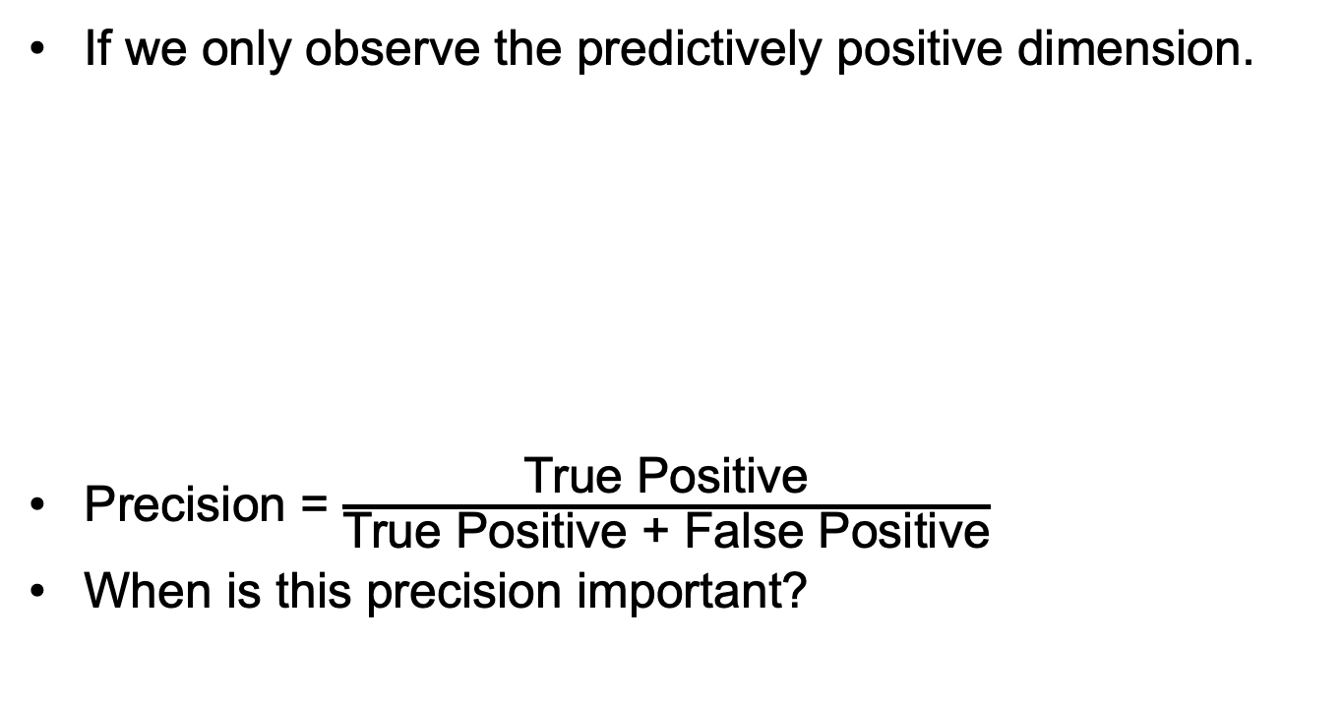
Confusion matrix & precision
If we only observe the predictively positive dimension.
Precision = $\frac{\text{True} \text{Positive}}{\text{True} \text{Positive} \text{+} \text{False} \text{Positive}}$
When is this precision important?
When it predicts positive, how often is it correct?

Slide 12
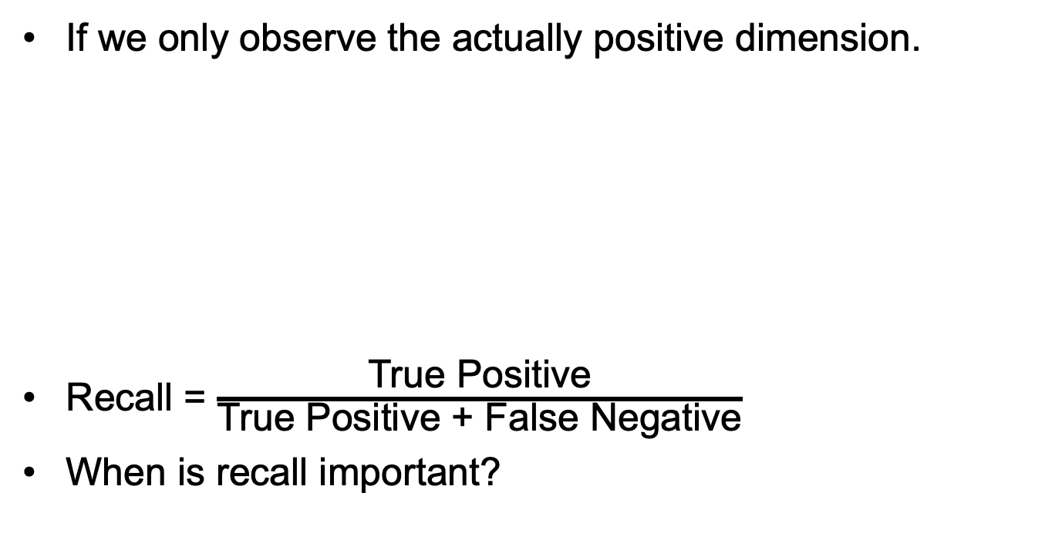
Confusion matrix & Recall
If we only observe the actually positive dimension.
Recall = $\frac{\text{True} \text{Positive}}{\text{True} \text{Positive} \text{+} \text{False} \text{Negative}}$
When is recall important?
Recall helps when the cost of false negatives is high.

Slide 13
Precision vs Recall
How does precision reach maximum? how much?
How does recall reach maximum? How much?
There’s a trade-off between precision and recall.
When precision increases, recall drops.
When recall increases, precision drops.

Slide 14
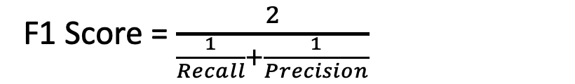
Other measures…
F1 score.
F1 is a helpful overall measure of a model’s accuracy that combines precision and recall.
- <Harmonic mean>
F1 Score = $\frac{2}{\frac{1}{Recall}+\frac{1}{Precision}}$
Balance between the precision and the recall.
Notes:
how often is our model correct

Slide 15
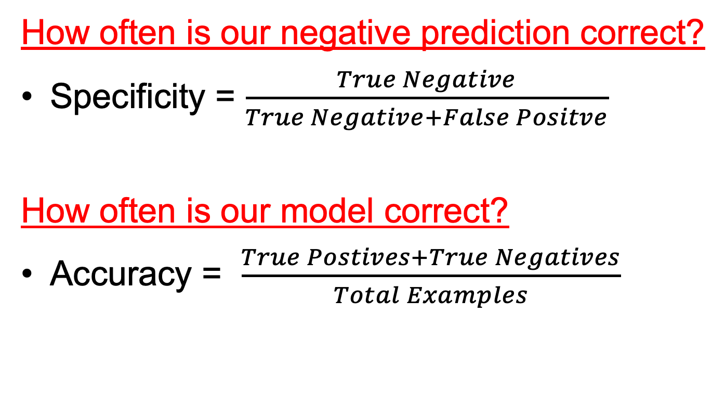
Other measures…
How often is our negative prediction correct?
Specificity = $\frac{True Negative}{True Negative+False Positve}$
How often is our model correct?
Accuracy = $\frac{True Postives+True Negatives}{Total Examples}$
Notes:
how often is our model correct

Slide 16
A quick summary

Slide 17
dimensionality
What if the class is not binary, but multi-dimensional?
Can you read the following graph?
On your paper, try writing down the equation to calculate the following: precision, recall, F1, accuracy for A

Slide 18
Take some time calculating these!
Rabbit precision = ?,
Rabbit recall = ?
Rabbit F-1 score = ?
Rabbit accuracy = ?

Slide 20
Cross Validation

Slide 23
Today
Introductions on evaluation
Topic on weka
Lab: getting started with Weka explorer

Slide 24
Getting started with Weka
Memory settings
Chapter 17: iris, glass

Slide 25
References:
https://towardsdatascience.com/beyond-accuracy-precision-and-recall-3da06bea9f6c
https://towardsdatascience.com/accuracy-precision-recall-or-f1-331fb37c5cb9
https://github.com/yingjun2/IS590dt-19SP

